Slide 1

SMART GLOVE
TECHNICAL HAND GLOVE FOR MUTE & DEAF

Slide 2
CREW MEMBERS
ATHEWITH K SURESH 7
SANJITH JAISON 28
SHAMIL OLLAKKAN 29
SUJITH V R 37

Slide 3
BLOCK DIAGRAM
INPUT
MICRO CONTROLLER
OUTPUT

Slide 4
COMPONENTS
ARDUINO UNO BOARD *1
16*2 LCD SCREEN *1
I2C MODULE *1
2.2 INCH FLEX SENSOR *4
10K OHM RESISTOR *4
CONNECTION WIRES

Slide 5
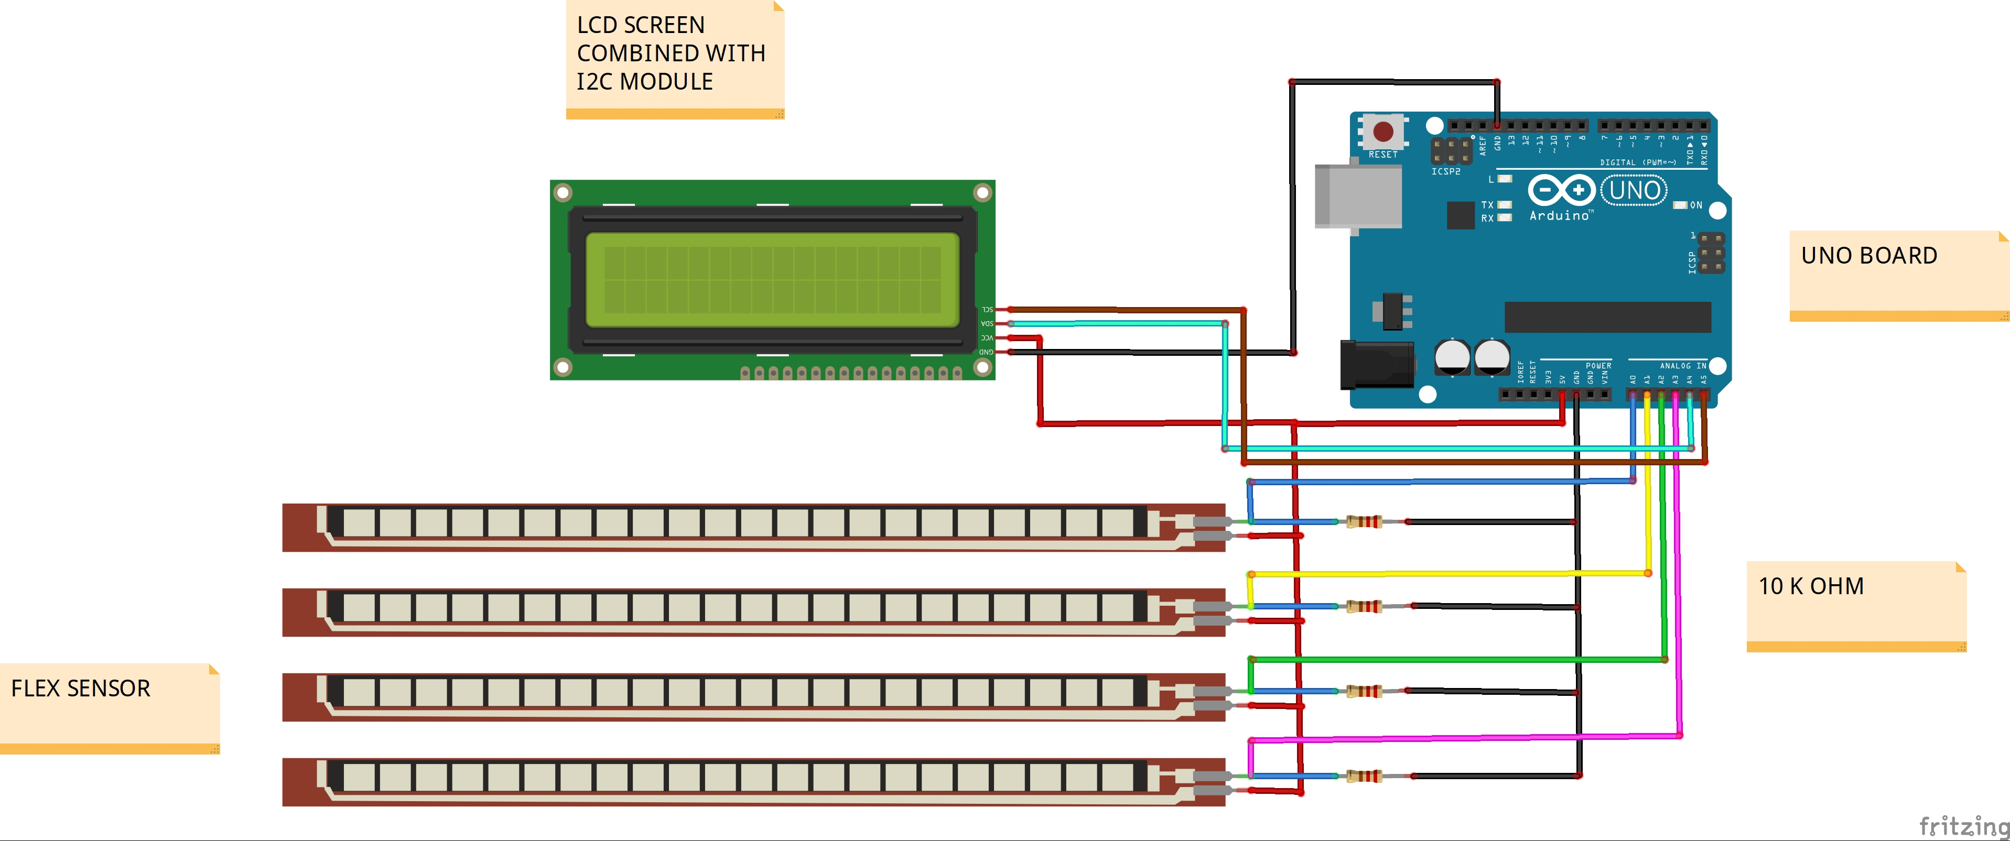
CIRCUIT DIAGRAM

Slide 6
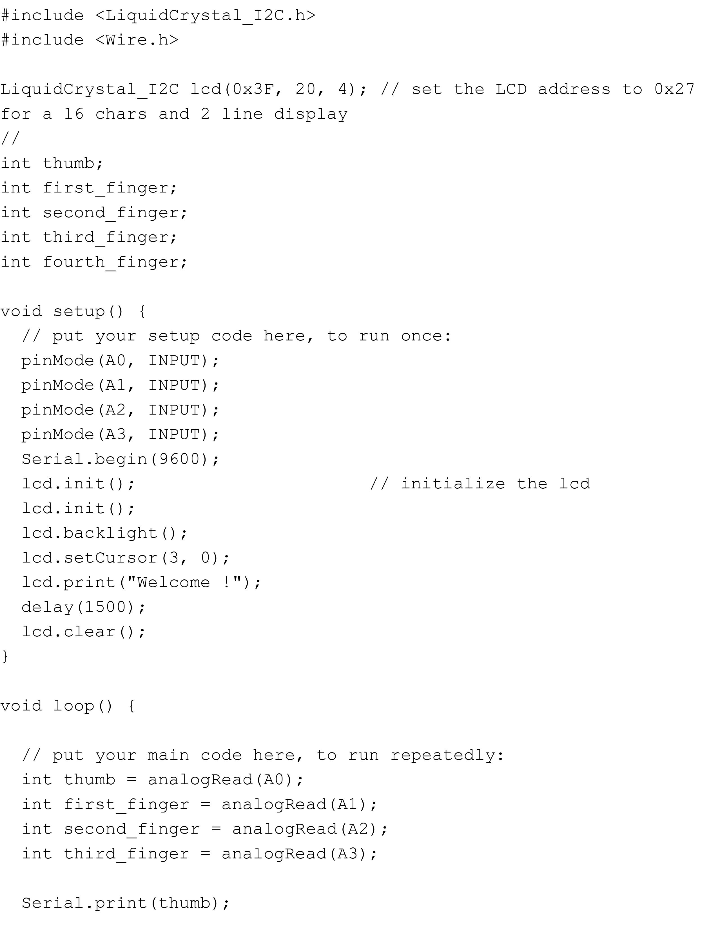
PROGRAM FOR ARDUINO

Slide 7
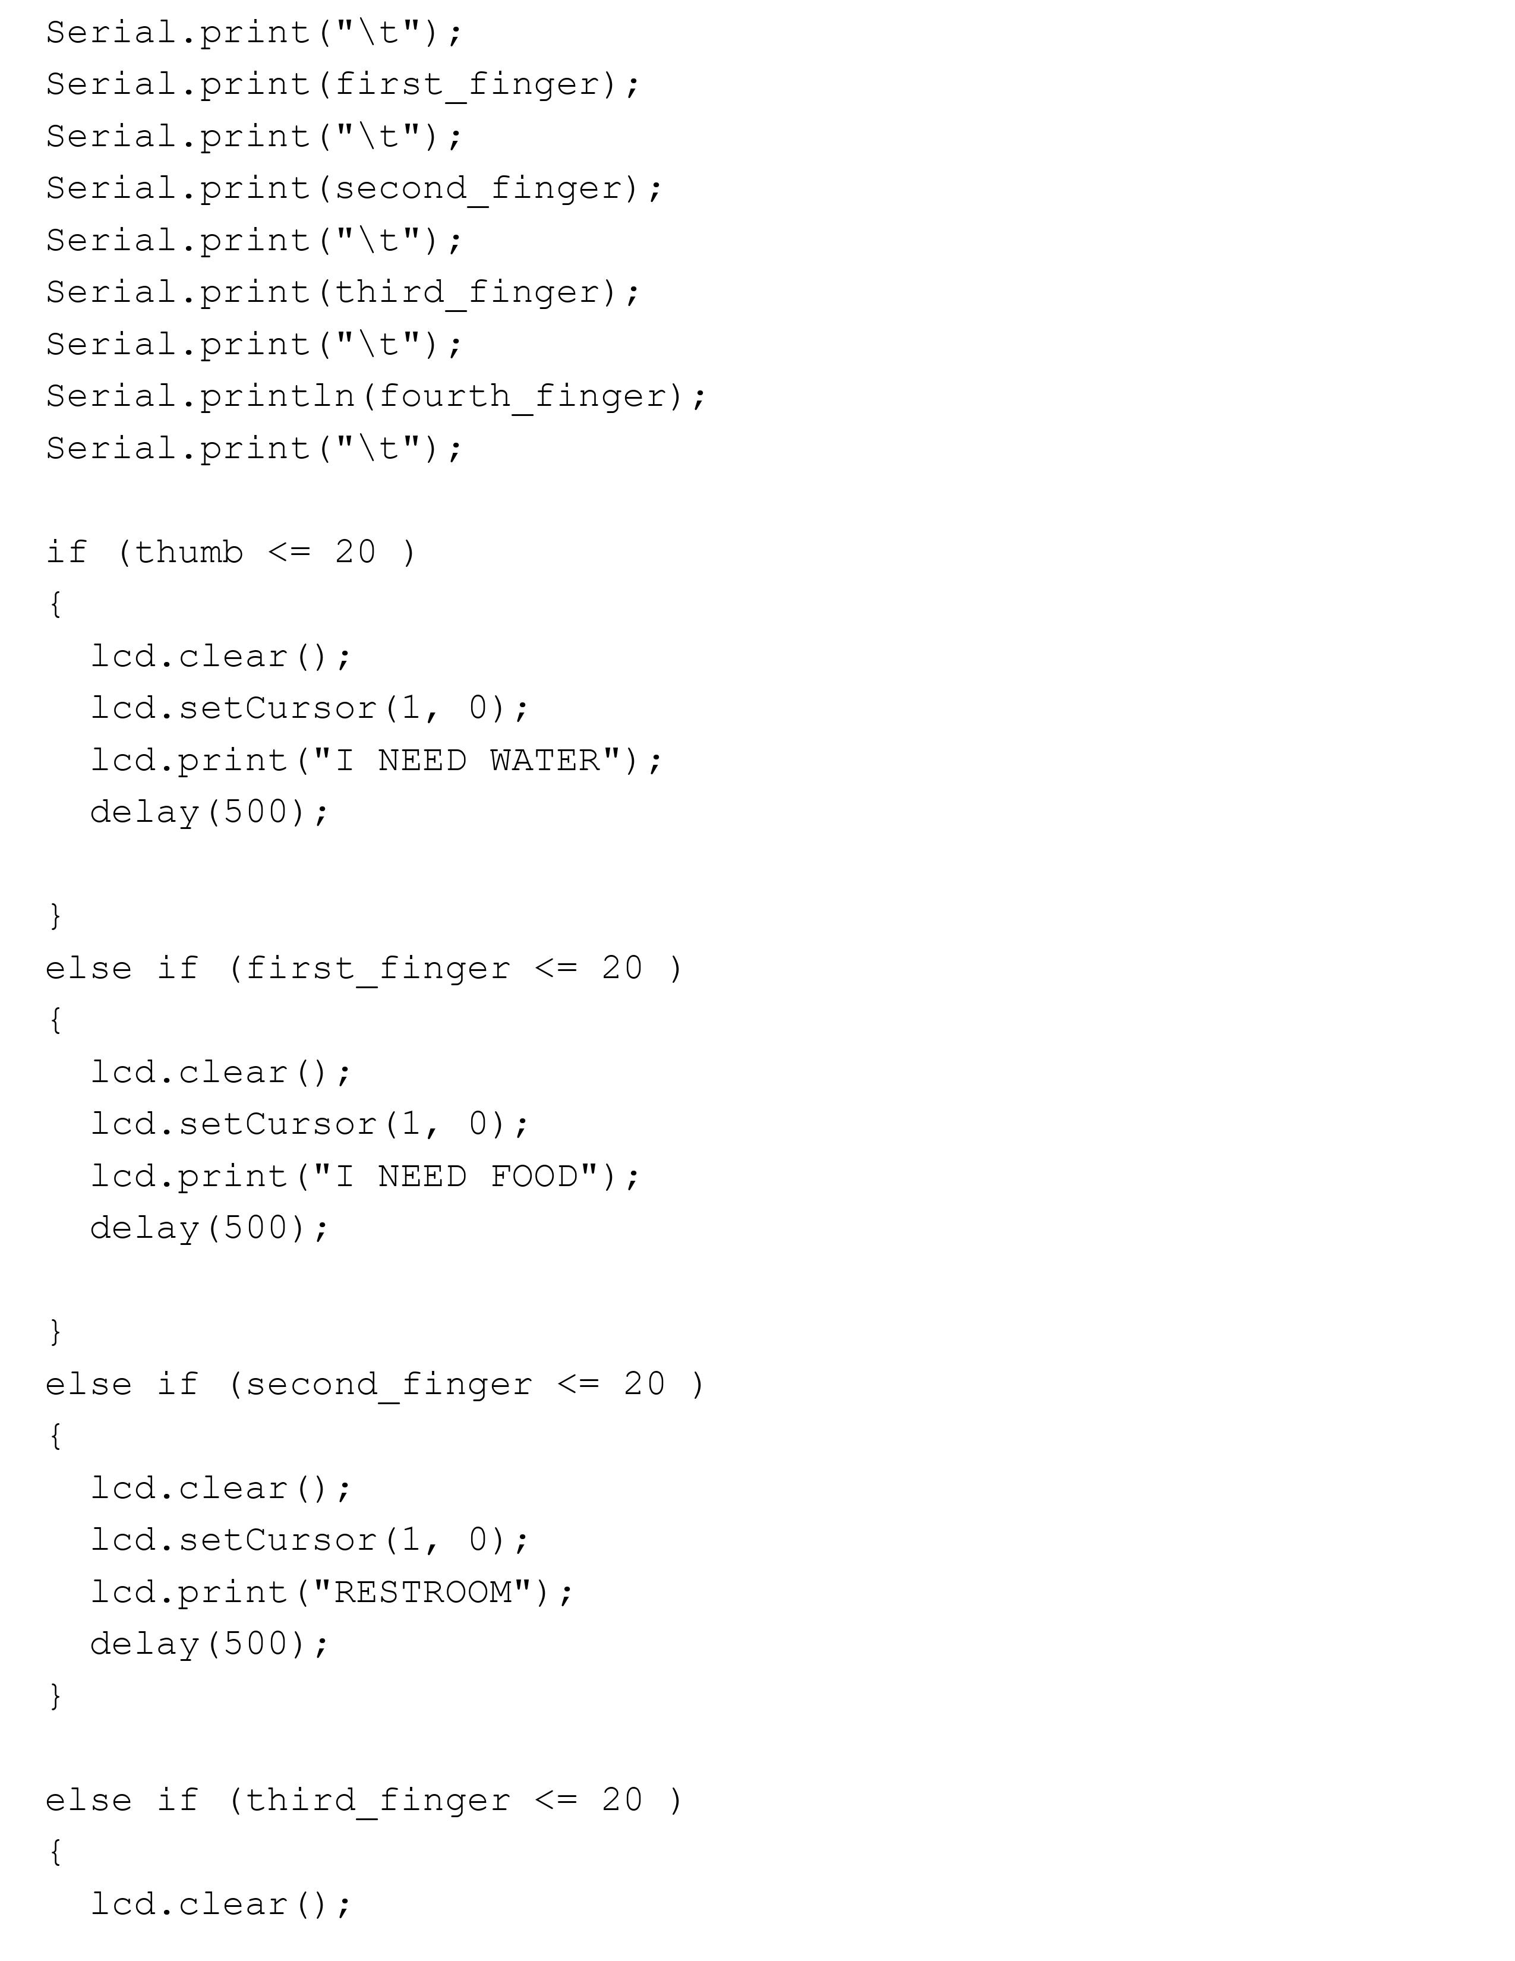
PROGRAM FOR ARDUINO (cont..)

Slide 8
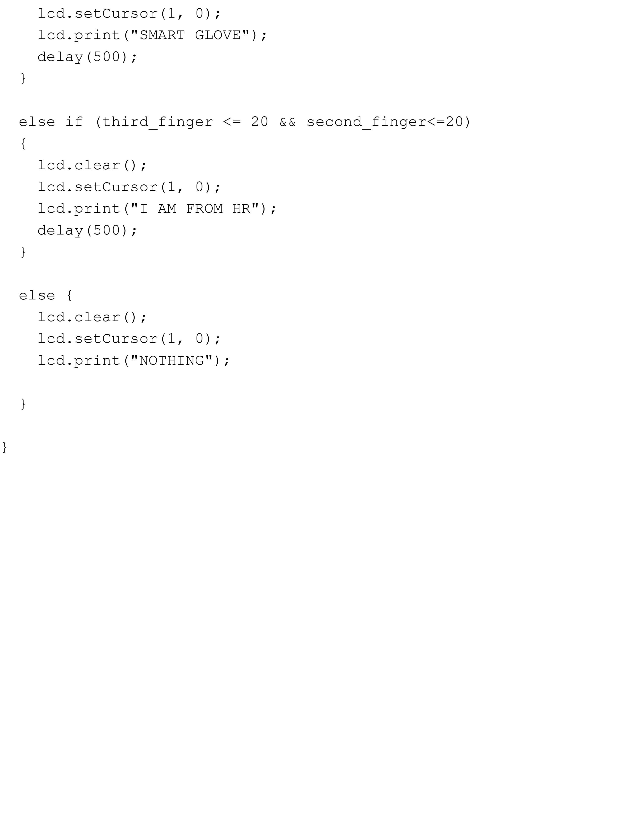
PROGRAM FOR ARDUINO (cont..)

Slide 9
ABOUT EMBEDDED C (language used for programming)
Embedded C is a set of language extensions for the C programming language by the C Standards Committee to address commonality issues that exist between C extensions for different embedded systems.
Embedded C programming typically requires nonstandard extensions to the C language in order to support enhanced microprocessor features such as fixed-point arithmetic, multiple distinct memory banks, and basic I/O operations.

Slide 10
ABOUT THE SOFTWARE
FRITZING
Fritzing is an open-source initiative^{[3]} to develop amateur or hobby CAD software for the design of electronics hardware, to support designers and artists ready to move from experimenting with a prototype to building a more permanent circuit.

Slide 11
WORKING
PROJECT IS INITIALIZED WITH A RECOGNIZED HAND GESTURE
BENDING OR DEFELCTION IS DETECTED IN THE FLEX SENSOR
AMOUNT OF BENDING IS RECORDED AND IS TRANSFERRED TO THE MICRO CONTROLLER ( ARDUINO UNO IS THE MICRO CONTROLLER USED)
SOFTWARE PROGRAMME IS CODED IN THE MICRO CONTROLLER. (LANGUAGE OF PROGRAM IS EMBEDDED C)
FROM THE DATA FLEX SENSOR TRANSFERRED IS COMPILED WITH PROGRAM AND MATCHING FUNCTON IS DETECTED
THE FINAL RESULT IS TRANSFERRED TO THE LCD SCREEN ACCOMPANIED WITH I2C MODULE
LCD SCREEN PRINT DESIRED FUNCTION

Slide 12
MICRO CONTROLLER
ARDUINO UNO BOARD
The Arduino Uno is an open-source microcontroller board based on the Microchip ATmega328P microcontroller and developed by Arduino.cc.^{[2][3]} The board is equipped with sets of digital and analog input/output (I/O) pins that may be interfaced to various expansion boards (shields) and other circuits.^{[1]} The board has 14 digital I/O pins (six capable of PWM output), 6 analog I/O pins, and is programmable with the Arduino IDE (Integrated Development Environment), via a type B USB cable.^{[4]} It can be powered by the USB cable or by an external 9-volt battery, though it accepts voltages between 7 and 20 volts. It is similar to the Arduino Nano and Leonardo.

Slide 13
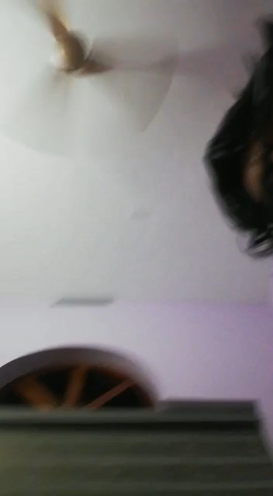
HARDWARE WORKING

Slide 14
ADVANTAGES
Easy to use
All technical parts are embedded in the hand glove itself
No external parts to carry with
Communication will be a lot easier for mute and deaf

Slide 15
DRAWBACKS
FOR COMMUNICATION GLOVES SHOULD BE WORN ALL THE TIME
CONTINOUS POWER SUPPLY SHOULD BE GIVEN TO THE MICRO CONTROLLER
RESULT IS LIMITED TO THE SIZE OF LCD SCREEN
COST OF COMPONENTS IS BIT HIGHER

Slide 16
HOW CAN WE OVERCOME THE DRAWBACKS?
COMFORTABLE AIR CIRCULATING GLOVES CAN BE USED
12 V RECHARGABLE BATTERY CAN BE EQUIPPED WITH THE DEVICE
LARGER LCD SCREEN WHICH IS ABLE TO EQUIP ON HAND ITSELF CAN BE USED

Slide 17
BEHIND THE SCREEN
IDEA OF PROJECT : SUJITH V R
CIRCUIT DESIGN: ATHEWITH K SURESH , SUJITH V R
PROGRAM CODING: SANJITH JAISON
HARDWARE ASSEMBLING: SHAMIL OLLAKKAN

Slide 18
COST OF COMPONENTS
ARDUINO UNO BOARD: 350 ₹
2.2 INCH FLEX SENSOR*4: 300₹*4= 1200₹
16*2 LCD SCREEN : 200₹
I2C MODULE FOR LCD SCREEN : 50₹
10K OHM RESISTOR * 4 = 1₹ * 4 = 4₹
BUNDLE OF WIRES = 10₹

Slide 19
REFERENCES
WIKIPEDIA
GEEKFORGEEKS
HACKSTER.IO
YOUTUBE VIDEOS

Slide 20
FINAL SUBMISSION
SUBMITTED DATE : 22/01/2021
SUBMITTED TO : AKHILA MAAM

